Slide 1
Working with Text Files

Slide 2
Using vim and vi to edit text files
Searching for files
Searching in files

Slide 3
Understanding the role of text files
Choosing an Editor
  vi vim
  emacs
  pico
  nano

Slide 4
Understanding vi Modes
  Command Mode This mode accepts commands, which are usually entered as single letters.
  Ex Mode To manipulate files, you use ex mode. You enter ex mode from command mode by typing a colon ( : ).
  Insert Mode You enter text in insert mode
  ESC

Slide 5
Using vim and vi to edit text files
Starting with vi
  vi /tmp/test
Adding text
  a—The add command. With this command, you can input text that starts to the right of the cursor.
  A—The add at end command. With this command, you can input text starting at the end of the current line.
  i—The insert command. With this command, you can input text that starts to the left of the cursor.
  I—The insert at beginning command. With this command, you can input text that starts at the beginning of the current line.
  o—The open below command. This command opens a line below the current line and puts you in insert mode.
  O—The open above command. This command opens a line above the current line and puts you in insert mode.

Slide 6
vi语法规则
  verb+noun
vi名词和动词
  h：左
  i： 下
  k：上
  l: 右
  w：移动到下词的开头
  }：跳到下一段
  $: 移动到本行末尾

Slide 7
  y:复制
  d:删除文本，保存到register
  c:删除文本，保存到register，并开始插入模式
  y$
  Dw
  C}
  y2h

Slide 8
Moving around in the text
  Arrow keys
  w—Moves the cursor to the beginning of the next word (delimited by spaces, tabs,or punctuation).
  W—
  b—Moves the cursor to the beginning of the previous word (delimited by spaces,tabs, or punctuation).
  B—
  0 (zero)—Moves the cursor to the beginning of the current line.
  $—Moves the cursor to the end of the current line.

Slide 9
Deleting, copying, and changing text
  dw
  db
  dd
  c
  y
  3dw

Slide 10
Pasting (putting) text
  P—Puts the copied text to the left of the cursor if the text consists of letters or words; puts the copied text above the current line if the copied text contains lines of text.
  p—Puts the buffered text to the right of the cursor if the text consists of letters or words; puts the buffered text below the current line if the buffered text contains lines of text.

Slide 11
Exiting vi
  ZZ—Saves the current changes to the file and exits from vi.
  :w—Saves the current file but doesn't exit from vi.
  :wq—Works the same as ZZ.
  :q—Quits the current file. This works only if you don’t have any unsaved changes.
  :q!—Quits the current file and doesn’t save the changes you just made to the file.

Slide 12
Text file
cat - Concatenate files
  The cat command reads one or more files and copies them to standard output like so:
  cat [file...]
  cat /etc/passwd
  cat -n /etc/passwd

Slide 13
head / tail – Print First / Last Part Of Files
  head -n 5 ls-output.txt
  head -4 myalllist
  tail -4 myalllist
  tail +10 myalllist
  tail -f /var/log/messages

Slide 14
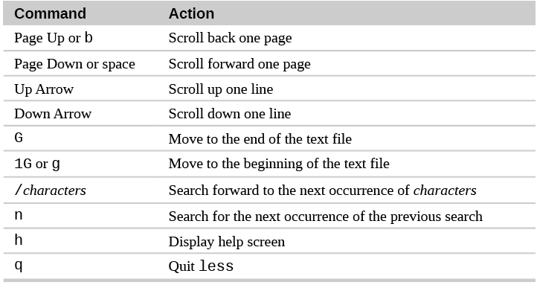
Less Is More
  less filename more /etc/passwd
  less /etc/passwd more +10 /etc/passwd

Slide 15
uniq - Report Or Omit Repeated Lines
  The uniq command is often used in conjunction with sort.
  uniq accepts a sorted list of data from either standard input or a single filename argument (see the uniq man page for details) and, by default, removes any duplicates from the list.

Slide 16
wc – Print Line, Word, And Byte Counts
  The wc (word count) command is used to display the number of lines, words, and bytes contained in files.
  wc ls-output.txt
  wc -l file
  $ wc -w file
  $ wc -c file

Slide 17
sort
  sort tool will sort lines alphabetically by default
  sort [OPTION]... [FILE]...
-r, -reverse | Reverse the result of comparisons
-t, --field-separator=SEP | SEP instead of non-blank to blank transition
-k, --key=POS1[, POS2] | Start a key at POS1 (origin 1), end it at POS2 (default end of line).
-n, --numeric-sort | Compare according to string numerical value.

Slide 18
  sort -k 3 data.txt
  sort –nk2 data.txt
  sort –t’,’ f3 data.txt

Slide 19
cut
  cut [OPTION]... [FILE]...
  writes to standard output selected parts of each line of each input file, or standard input if no files are given or for a file name of '-'
Tag | Description
-d, --delimiter=DELIM | use DELIM instead of TAB for field delimiter
-f, --fields=LIST | select only these fields; also print any line that contains no delimiter character, unless the -s option is specified
-c, --characters=LIST | select only these characters
-b, --bytes=LIST | select only these bytes

Slide 20
cut -c 3 file.txt
cut -c 1-3 file.txt
cut -d ':' -f 1 /etc/passwd

Slide 21
Finding Files
Using locate to find files by name
  On most Linux systems (Fedora and RHEL included), the updatedb command runs once per day to gather the names of ﬁles throughout your Linux system into a database.
  By running the locate command, you can search that database to ﬁnd the location of ﬁles stored in that database.
  Advantage and disadvantage

Slide 22
Searching for files with find
  search for files in a directory hierarchy
  find [path...] [expression]
  $ find
  $ find /etc
  # find /etc
  $ find $HOME -ls

Slide 23
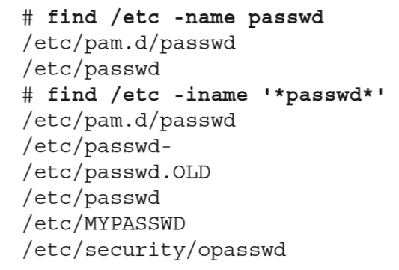
Finding files by name

Slide 24
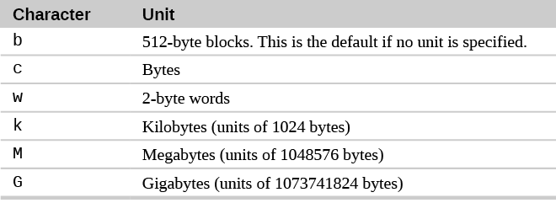
Finding files by size
  $ find /usr/share/ -size +10M
  $ find /mostlybig -size -1M

Slide 25
Finding files by user
  $ find /home -user chris -ls
  # find /etc -group ntp -ls

Slide 26
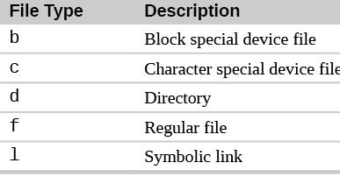
Finding files by type
find ~ -type d
find ~ -type f

Slide 27
Finding files by permission
  $find /bin -perm 755 –ls
  $ find /home/chris/ -perm -222
  $ find /myreadonly -perm +222
  $ find . -perm -002 –ls
  find / -perm /222
the "-" prefix as meaning "at least these bit(s) must be set for a file to match".

Slide 28
File and directory timestamps in Unix
  atime – File Access Time
  Access time shows the last time the data from a file was accessed – read by one of the Unix processes directly or through commands and scripts.
  ctime – File Change Time
  ctime also changes when you change file's ownership or access permissions. It will also naturally highlight the last time file had its contents updated.
  mtime – File Modify Time
  Last modification time shows time of the last change to file's contents. It does not change with owner or permission changes, and is therefore used for tracking the actual changes to data of the file itself.
amin,mmin and cmin

Slide 29
  ls -lt
  ls -lc
  ls –lu
  stat /tmp/file1

Slide 30
Finding files by date and time
  $ find /etc/ -mmin -10
  $ find /bin /usr/bin /sbin /usr/sbin -ctime -3
  $ find /var/ftp /var/www -atime +300

Slide 31
$ find /bigdata -size +500M -size -5G -exec du -sh {} \;

Slide 32
Using ‘not’ and ‘or’ when finding files
  $ find /var/all \( -user joe -o -user chris \) -ls
  $ find /var/all/ -user joe -not -group joe –ls
  $ find /var/all/ -user joe -and -size +1M –ls
# find /home -user chris -or -user joe –ls
  # find /var/spool -not -user root –ls

Slide 33
  $ find /home/chris/ -perm -222 -type d -ls
  $ find /myreadonly -perm +222 -type f
  $ find . -perm -002 -type f -ls

Slide 34
Finding files and executing commands
  $ find [options] -exec command {} \;
  $ find [options] -ok command {} \;
  $ find /etc -iname iptables -exec echo "I found {}" \;
  # find /var/allusers/ -user joe -ok mv {} /tmp/joe/ \;

Slide 35
  $ find . -name '*.tmp' -exec rm {} \;
  $ find logs -type f -mtime +7 -exec -ok rm {} \;
  $ find . -name '*.repo' -type f -exec mv {} {}.bak \;
  $ find / ( -name a.out -o -name ‘*.o’ ) -atime +7 ! -fstype vfat -exec rm {} \;

Slide 36
Searching in files with grep
grep
  The grep command searches for a pattern of characters in a file or multiple files.
  If the pattern contains white space, it must be quoted
Synopsis
  grep [OPTIONS] PATTERN [FILE...]

Slide 37
Option | Description
-i | Ignore case. Do not distinguish between upper and lower case characters. May also be specified --ignore-case.
-v | Invert match. Normally, grep prints lines that contain a match. This option causes grep to print every line that does not contain amatch. May also be specified --invert-match.
-n | Prefix each matching line with the number of the line within the file. May also be specified --line-number

Slide 38
$ grep desktop /etc/services
desktop-dna 2763/tcp # Desktop DNA
desktop-dna 2763/udp # Desktop DNA
$ grep -i desktop /etc/services
sco-dtmgr 617/tcp # SCO Desktop Administration Server
sco-dtmgr 617/udp # SCO Desktop Administration Server
airsync 2175/tcp # Microsoft Desktop AirSync Protocol
grep Tom /etc/passwd

Slide 39
$ grep -vi tcp /etc/services
$ grep -rli peerdns /usr/share/doc/

Slide 40
Regular Expression
What Are Regular Expressions?
  A regular expression (regex or regexp for short) is a special text string for describing a search pattern.

Slide 41
Regular expressions have many uses cases, which include:
  form input validation
  web scraping
  search and replace
  filtering for information in massive text files such as logs
Different Regular Expression Engines

Slide 42
The grep understands three different types of regular expression syntax as follows:
  basic (BRE)
  extended (ERE)
  perl (PCRE)

Slide 43
The Any Character
  A dot or period character, which is used to match any character.
  b.g The big bag of bits was bugged.
  l..e You can live like a king.

Slide 44
Character Classes and Bracket Expressions
  A bracket expression is a list of characters enclosed by [ and ].
  It matches any single character in that list;
  A set may contain any number of characters, and metacharacters lose their special meaning when placed within brackets
  there are two cases in which metacharactersare used within bracket expressions(“-” and “^)

Slide 45
[1-8] | Room Allocations: G4 G9 F2 H1 L0 K7 M9
[1-5a-fx] | y, w, a, r, f, 4, 9, 6, 3, p, x, t
New[a-e] | Newa , Newb ,newa
New[0-9][a-z] | New0d, New4f
t[^eo]d | When today is over Ted will have a tedious time tidying up.
[1-49] | G4 G9 F2 H1 L0 K7 M9

Slide 46
A character class matches any one of a set of characters. It is used to match the most basic element of a language like a letter, a digit, space, a symbol etc.
  /s : matches any whitespace characters such as space and tab
  /S : matches any non-whitespace characters
  /d : matches any digit character
  /D : matches any non-digit characters
  /w : matches any word character (basically alpha-numeric)
  /W : matches any non-word character
  /b : matches any word boundary (this would include spaces, dashes, commas, semi-colons, etc)

Slide 47
Anchoring
  ^ matches the beginning of the line.
  $ matches the end of the line.
  ^x
  ^the
  x$
  ^[0-9]
  ^[0-9][0-9]$ 1234

Slide 48
Quantifiers
  Quantifiers repeat the preceding clause of a regular expression

Slide 49
Fixed repetitions {n}
Min and max repetitions {n,m} {n,}
0 or 1 repetition (?)
1 or more repetitions(+)
0 or more repetitions (*)

Slide 50
Repetition
? | the preceding character matches 0 or 1 times only. | xy? | x, xy
* | the preceding character matches 0 or more times. | xy* | x, xy, xyy, xyyy …
+ | the preceding character matches 1 or more times. | xy+ | xy, xyy, xyyy …
{n} | The preceding item is matched exactly n times. | go{2}gle | google
{n,} | The preceding item is matched n or more times. | go{2,}gle | google, gooogle, goooogle …
{n,m} | The preceding item is matched at least n times, but not more than m times. | go{2,4}gle | google, gooogle, goooogle

Slide 51
Metacharacter | Function | Example | What It Matches
\< | Beginning of word anchor | '\<love' | Matches lines containing a word that begins with love.
\> | End of word anchor | 'love\>' | Matches lines containing a word that ends with love.
x\{m\} x\{m,\} x\{m,n\} | A Repetition of character x, m times, at least m times, or between m and n times | 'o\{5\}' 'o\{5,\}' 'o\{5,10\}' | Matches if line has 5 o’s, at least 5 o’s, or between 5 and 10 o’s
\(..\) | Tags matched characters | '\(love\)ing' | marked portion in a register to be remembered later as number 1. To reference later, use \1 to repeat the pattern. May use up to nine tags, starting with thefirst tag at the leftmost part of the pattern. For example, the pattern love is saved in register 1 to be referenced later as \1.

Slide 52
Groups
  if we wanted the effect to apply to a section of the expression. we can do this by creating groups using round brackets — ().
([A-Z][0-9]{3})+ | A563, A563X264,B123C12
([A-Z][0-9]{3}-?)+ | A563-X264-C578, A123B123,
([0-9]{3}-)?[0-9]{3}-?[0-9]{4} | 470-127-7501
([0-9]{3}-?)?[0-9]{3}-?[0-9]{4} | 127-7501

Slide 53
Alternation
  Two regular expressions may be joined by the infix operator |; the resulting regular expression matches any string matching either alternate expression.
[0-9]{3}(35|75) | 75035
[0-9]{3}(35|75) | 75062
ALPHA|BETA|GAMMA | BETA

Slide 54
Prefixes and suffixes
  (?<=regex) and (?=regex)

Slide 55
...x..x..x
^d
^the
sh$
^....$
^$
\.
^.2
\*\.pas
t.*\.sh$
t*\.sh$
.a.*

Slide 56
gr(a|e)y
(^To:|^From:) (Seaman|Ramsay )
[0-9]\{2\}-[0-9]\{2\}-[0-9]\{4\}
(yellow|red) flower(s)?
/etc/rc\.d/init\.d/httpd
/usr/sbin/httpd(\.worker)?
/var/www(/.*)?/logs(/.*)?
/var/log/apache(2)?(/.*)?
/var/www/[^/]*/cgi-bin(/.*)?
/srv/([^/]*/)?www(/.*)?
/usr/lib(64)?/httpd(/.*)?

Slide 57
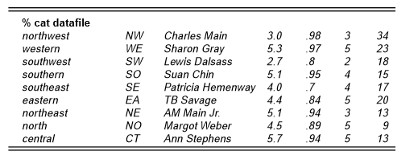


Slide 58
grep TB Savage datafile
grep: Savage: No such file or directory
datafile:eastern EA TB Savage 4.4 .84 5 20
grep ’TB Savage’ datafile
eastern EA TB Savage 4.4 .84 5 20

Slide 59
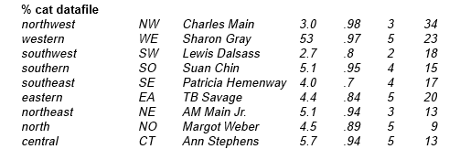

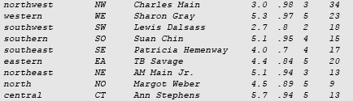

Slide 60


Slide 61

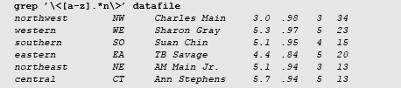

Slide 62


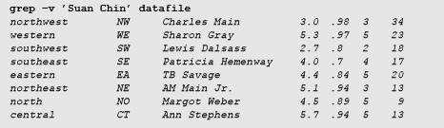
grep with Options

